Slide 1
17.01.2025

Slide 2
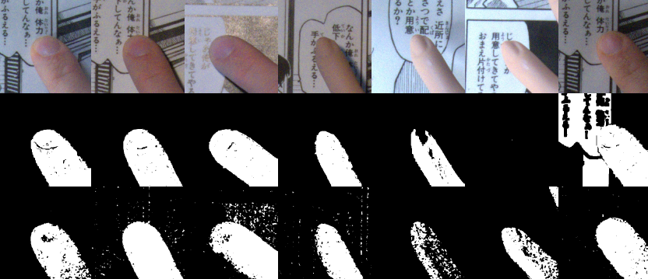
Finger Recognition
Skintone
Floodfill

Slide 3
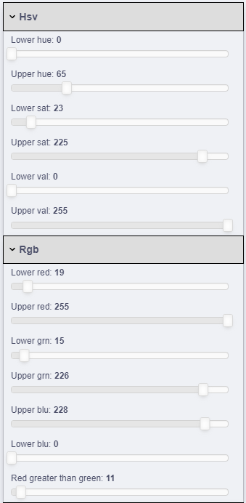
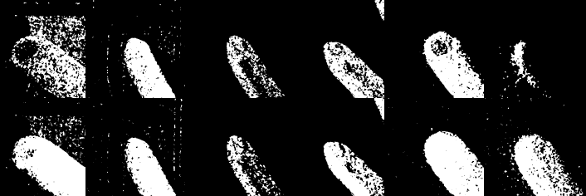
Tweeking Skintone Approach

Slide 4
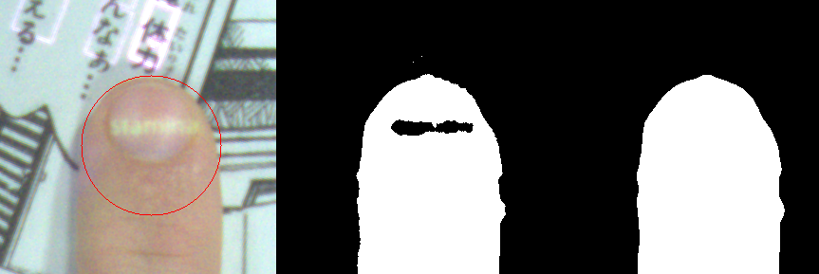
Estimating Fingertip Circle
median width
= diameter

Slide 5
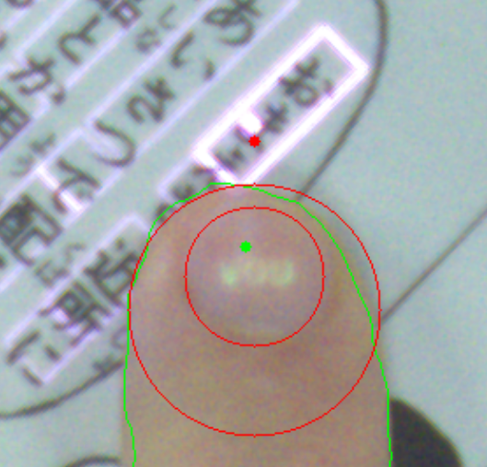
Estimating Fingernail Area

Slide 6
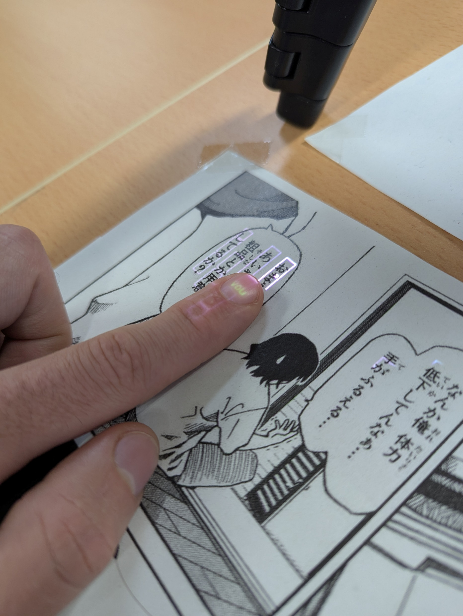

Slide 7
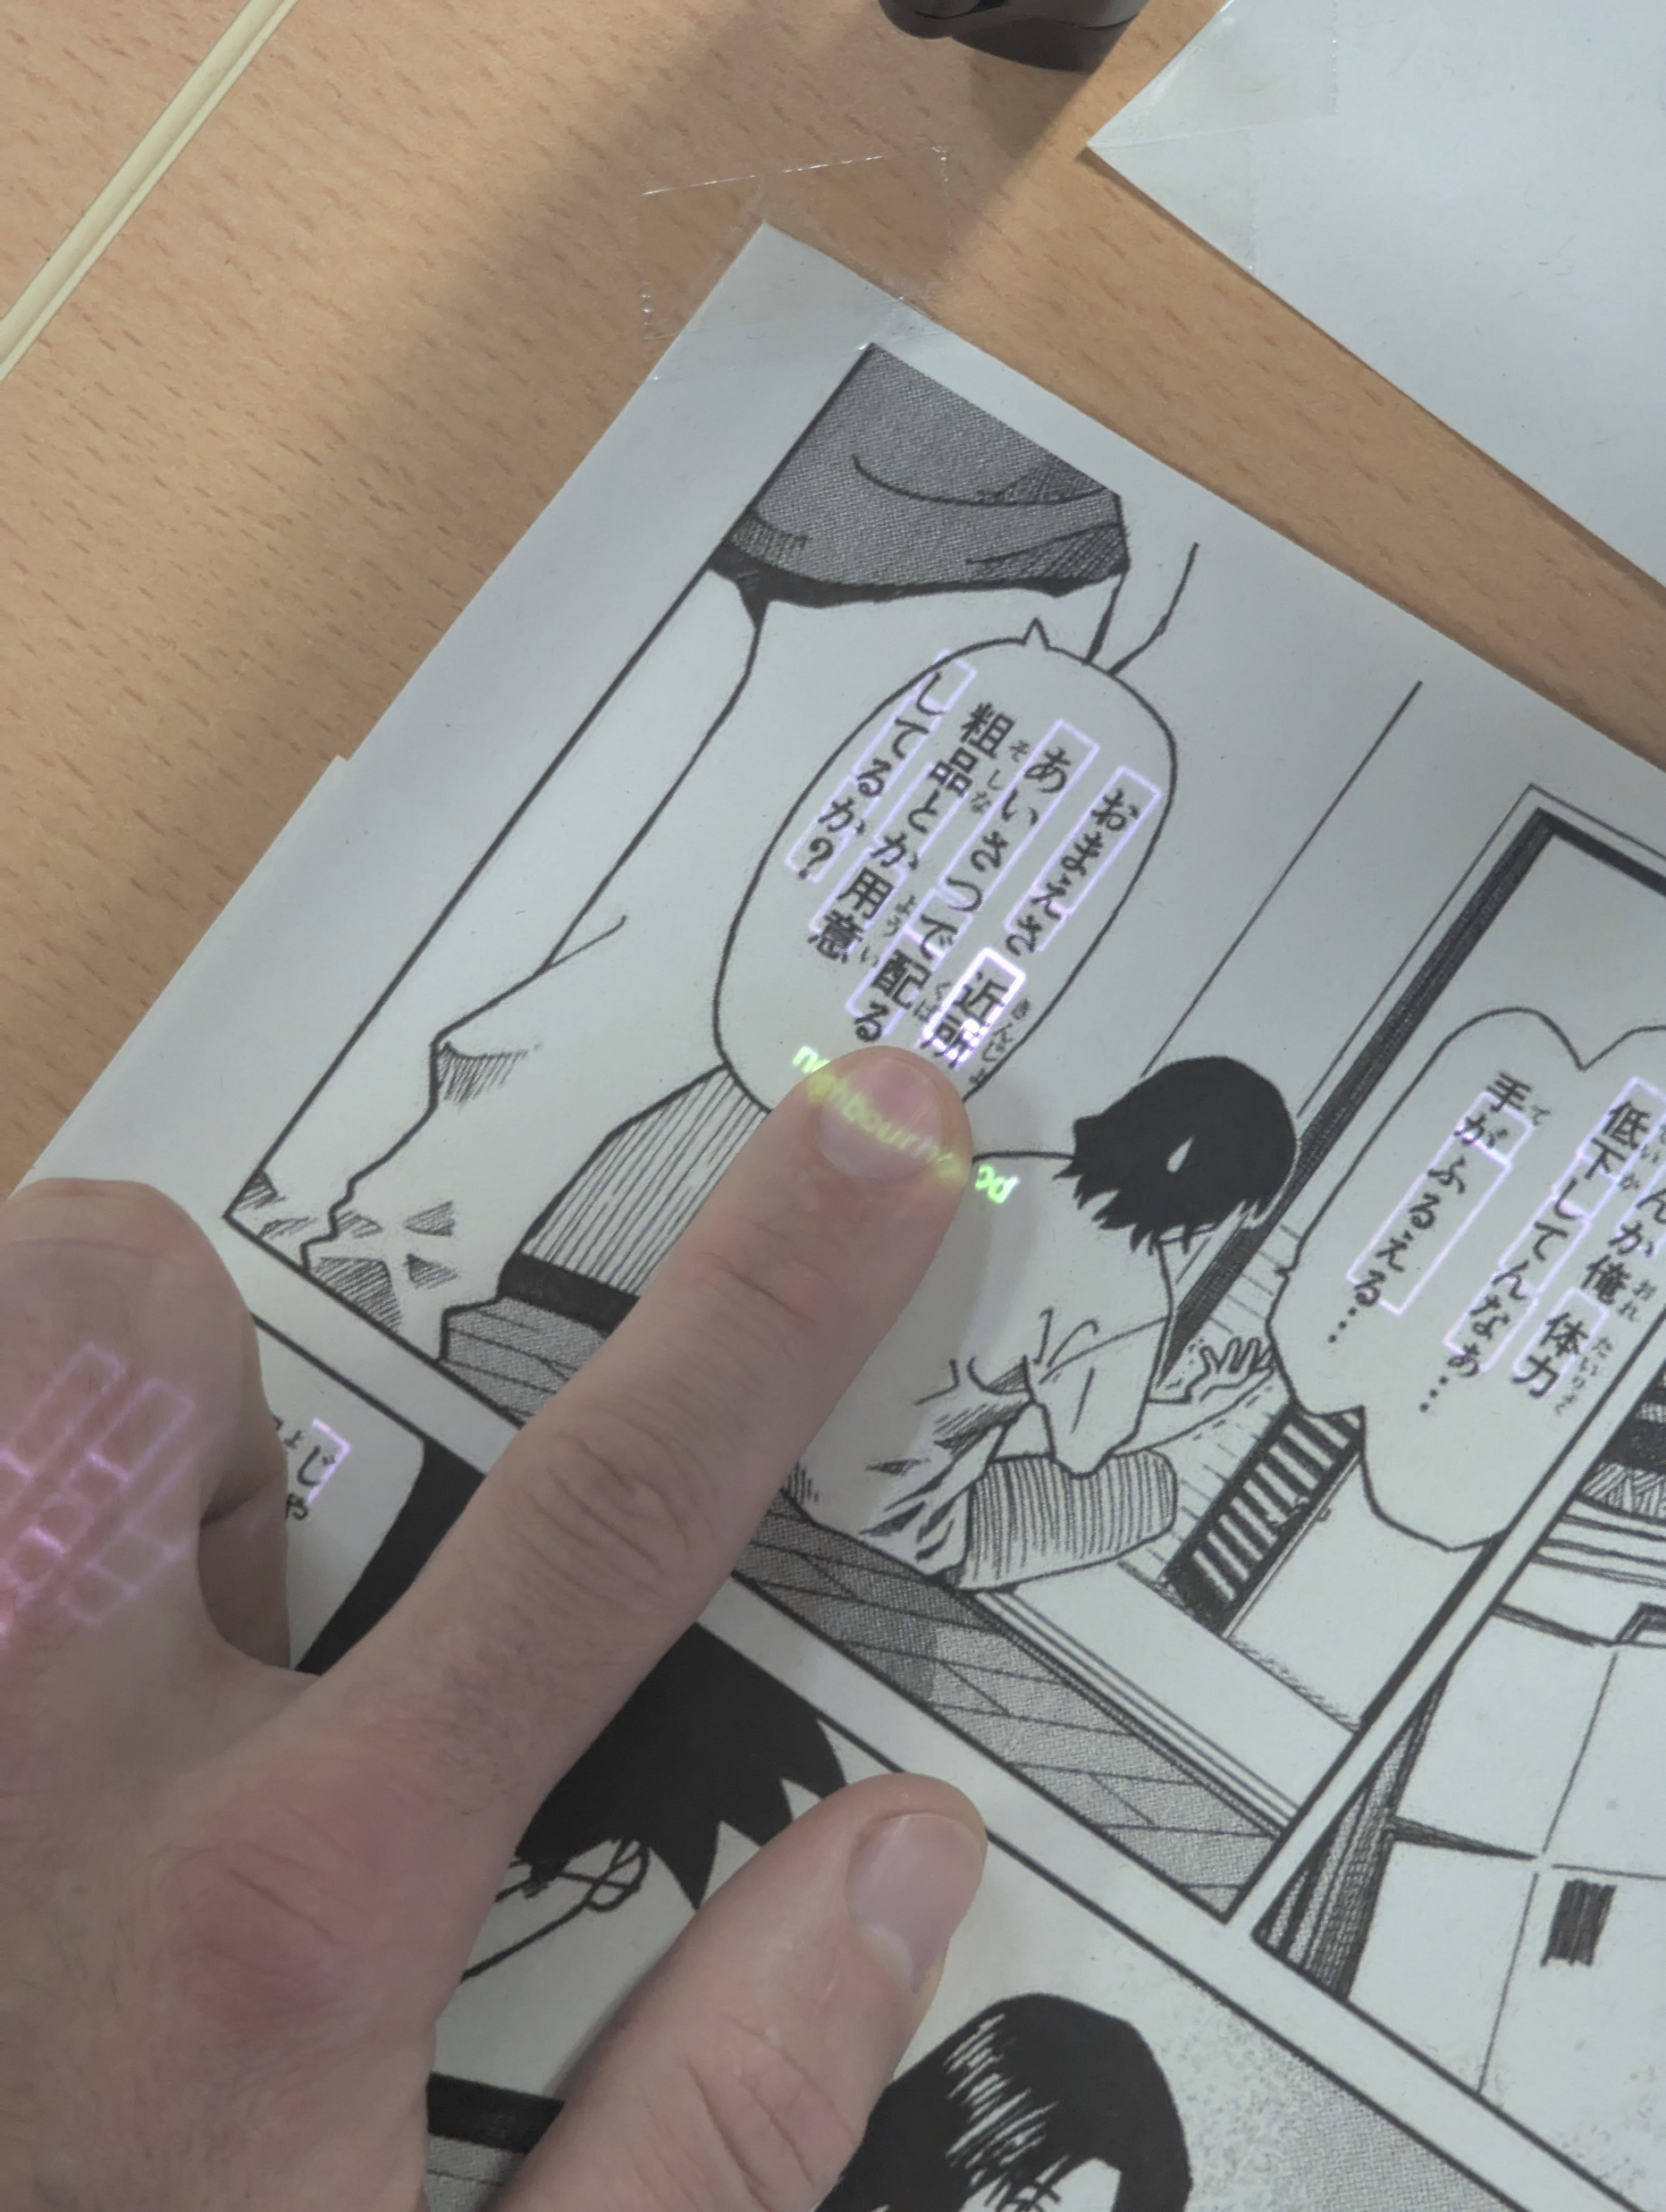

Slide 8
24.01.2025

Slide 9
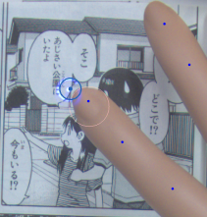
Detecting standstill

Slide 10
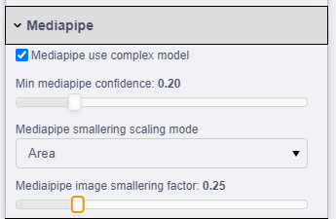
Performance: 3 fps → 10 fps

Slide 11
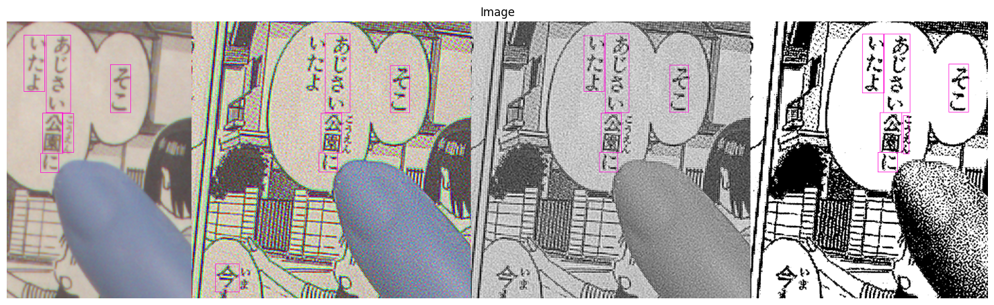
Preprocessing OCR image

